Slide 1
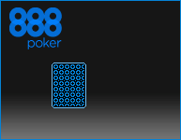
Poker 6.0 Overview

Slide 2
Why Poker 6.0?
Software was improved in terms of usability and functionality
Client was re-deigned completely to create modern and appealing look
The client was re-coded from scratch to allow better performance and modular approach for future features
2

Slide 3
Main Lobby – new features
1-click “Beginners” lobby
“My Favorites” – lobby for advanced users
Icons for table formats
“Upcoming Tournaments” – clear call to action
Simplified My Account
Jackpot display
3

Slide 4
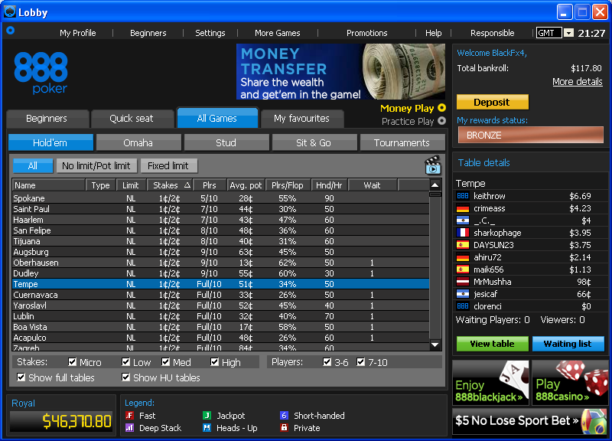
Main Lobby
Switching between Real and Demo is done by selecting a radio button
“Mini my account area” became less crowded and cleaner.
Icons signify special tables and tournaments under the Type column
Royal Jackpot
Icons’ legend
The player has the option though to see the previous balance format using the ‘more details’ tooltip
4

Slide 5
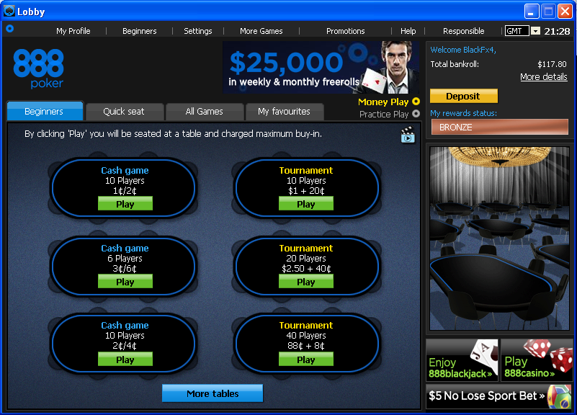
Beginners Lobby
Unique lobby, designed for beginners.
The tab displays a variety of six tables: cash games and tournaments, all with low stakes / buy-in.
The player is always one-click-away from the poker game action.
There is a different atmosphere in this lobby, and avoids the Excel-like table that is generally common in poker software.
5

Slide 6
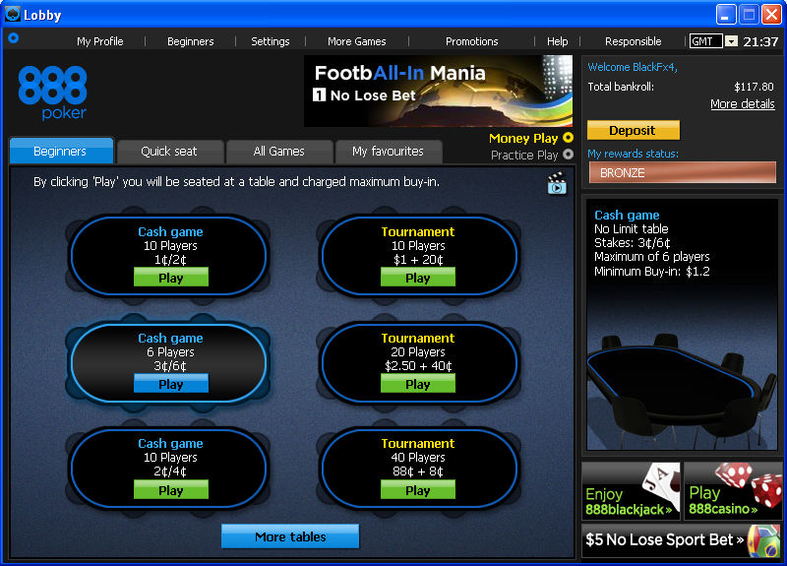

Beginners’ Tab – mouse over table
Hovering with the mouse over one of the tables will display additional information about the table, in the right-hand box.
Clicking the ‘Play’ button will take the player to the table instantly.
The ‘More tables’ button will take the player to the ‘Quick seat’ tab
6

Slide 7
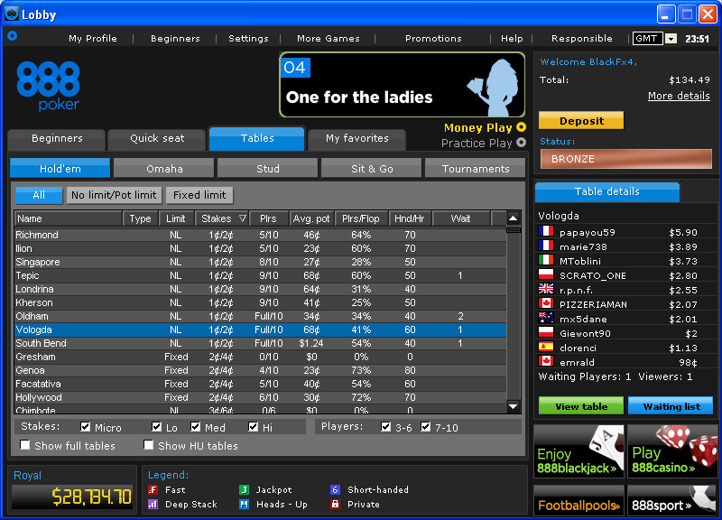
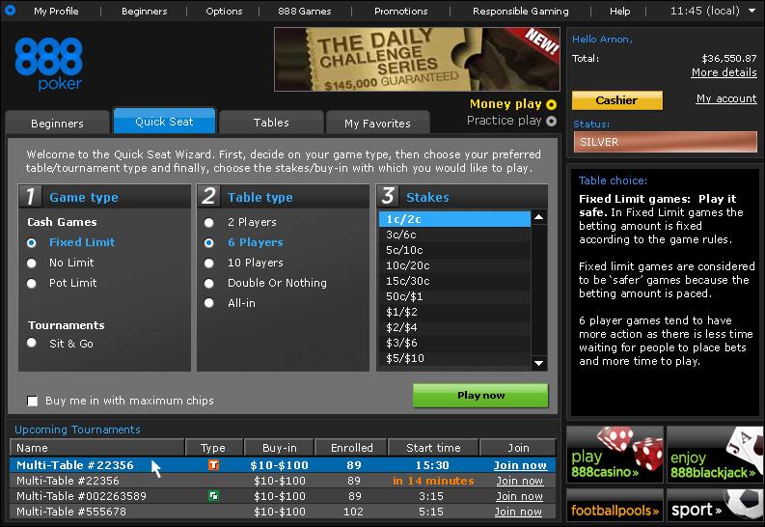
Quick Seat and Upcoming Tournaments
The Quick seat wizard remained almost unchanged
Players may read a detailed explanation about their selection
The Upcoming tournaments section displays scheduled tournament that are about to begin within the next hour.
7

Slide 8
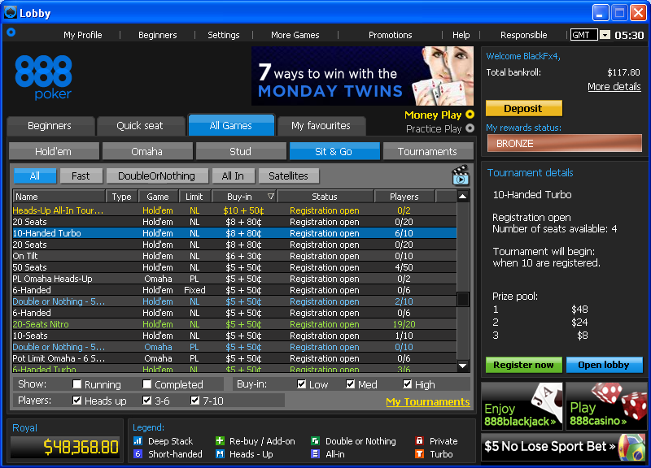
Main Lobby – All games tab
The All games tab displays the classic look of the lobby’s table
In SnGs, the prize of the first 3 places is displayed in the main lobby
It is possible to register to tournaments directly using the Register now button
The tabs (buttons) replaced the radio buttons that were on that place in previous versions
Basic filters help the player to refine their choice
Tabs format was re-arranged to be aligned with the rest of the industry
8

Slide 9
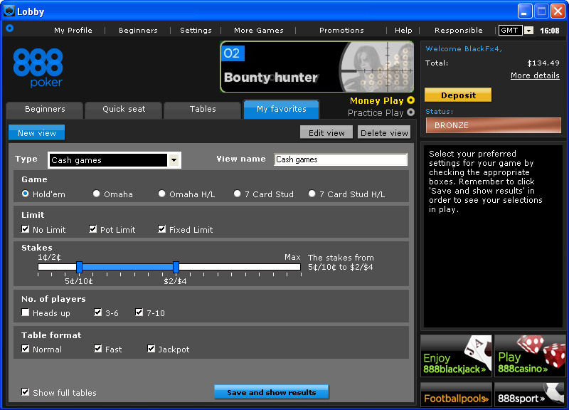
My Favorites (Advanced) Lobby – cash games view
My favorites tab enables the players to customize and save up to 5 different views (profiles) with their favorite settings
The player needs to choose the game type and the view name. Then, adjust the screen’s filters according to their wish
Stakes slider can be adjusted to the right range
When finished, the player hits the save and show result button
9

Slide 10
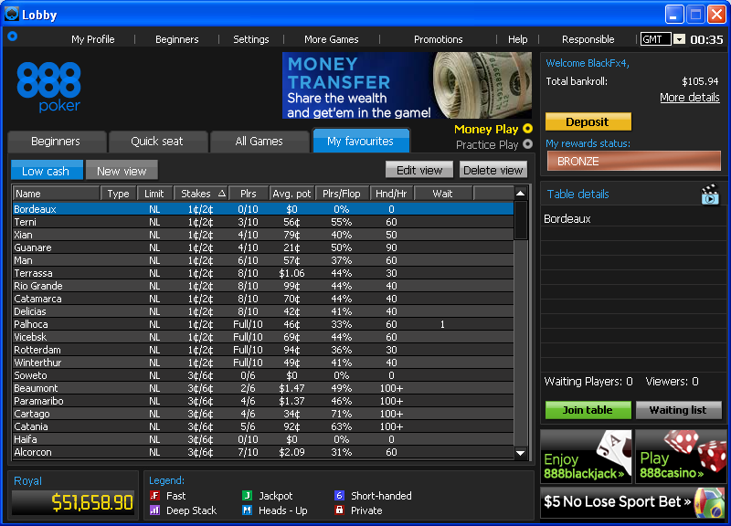
“My Favorites”– result page
The results’ page looks exactly like the All games tab
A new view is opened automatically (same as in IE7). A player can define up to 5 different views
Once saved, the view presents the results according the chosen criteria. The view’s name bears the name that was set by the player
The player can edit a view (not the game type though) or delete an existing view in order to create a new one
10

Slide 11
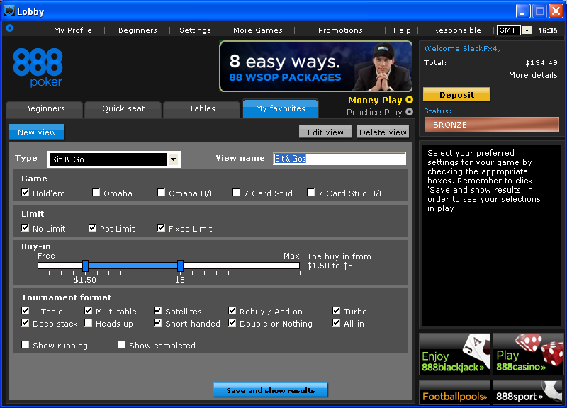
My Favorites Lobby – SNGs view
In SnG type, the buy-in is set using a slider, and the player can choose their favorite tournament formats
11

Slide 12
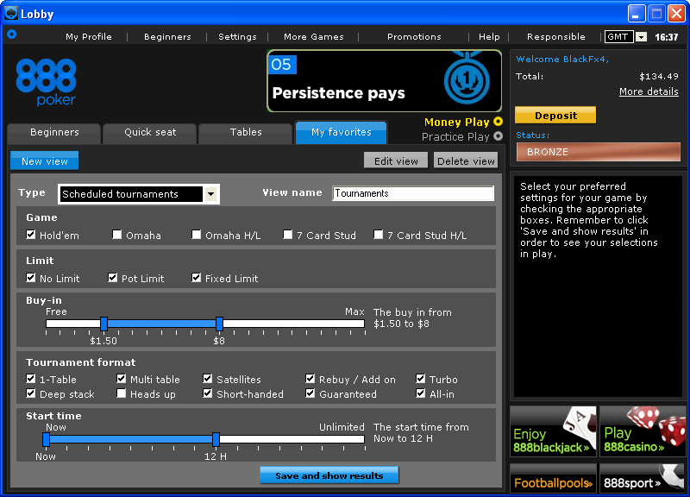
My Favorites – tournaments view
In scheduled tournaments type, the player can adjust the requested tournament start time
12

Slide 13
Tournament Lobby – new features
“Complete makeover” of the lobby
Use of icons for tournament formats
‘Satellites for this tournament’
News area will be utilized for marketing info
Full player’s dashboard in Running mode
Automatic Data Display (Info): starting chips, R&A information, blinds levels..
‘Find me’
Open identical SnG button
13

Slide 14
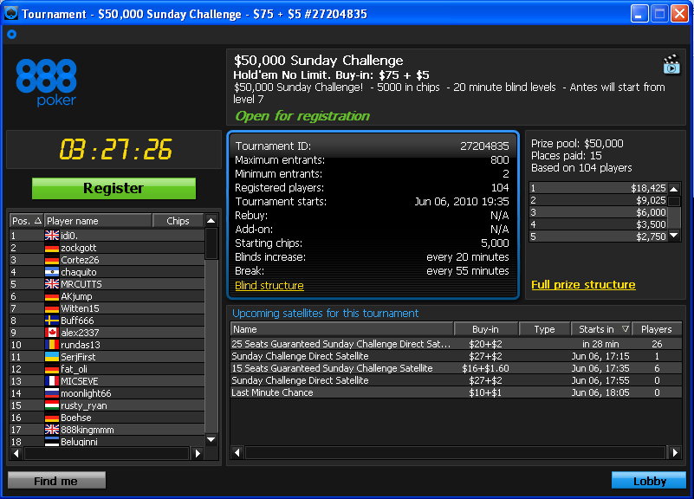
Tournament Lobby – Open for Reg.
Tournament basic information + news + tournament status
Start time countdown (24H before the tournament starts)
Tournament details (everything is extracted automatically from the Info-Server)
Registration button
Prize pool list
Upcoming satellites to this tournament (double click will open the satellite tour lobby)
Registered players’ list
14

Slide 15
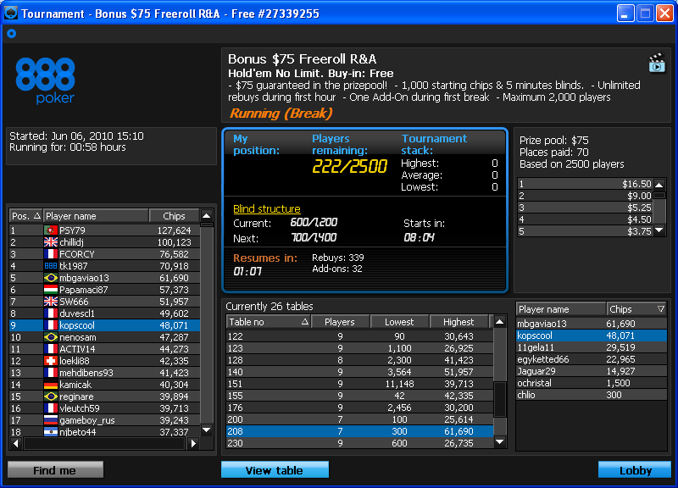
Tournament Lobby – Running
Total number of players in the tournament, and the remaining players
Player’s dashboard – contains useful online information about the tournament, that updates dynamically during the tournament
Player’s current position in the tournament and expected prize for that position
Recess information
Rebuys & add-ons information
Selecting a player in the list will automatically highlight their table and their position in the table in the tables to the right
Optional link to promotion page
List of players, sorted according to their position in the tournament
List of players on a chosen table
List of active tables
‘Open identical’ button enables the player to open an identical tournament lobby (appears only in SnG on Running state)
The ‘Find me’ button finds the player’s username in the list, and highlights its table and position.
Viewing the action on a chosen table
Chip stacks information
Current and next blind levels, and a countdown toward the next level
15

Slide 16
Table – new features
Number of seats in the table = number of players
Sit Here feature
Mark opponent as.. (animals)
Color indicated action
Blocking Players / Dealer / Observers chat
“Fold to any bet”
Renewed Player’s Notes screen
Rich personal image gallery
Player’s information in a tooltip
16

Slide 17
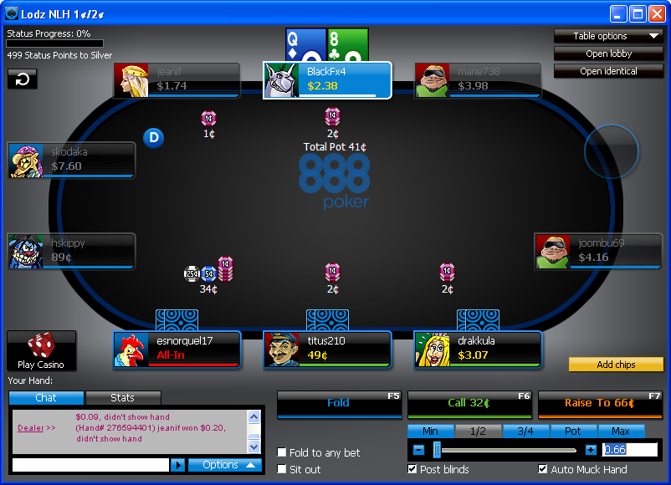
Table Screen
Replay last hand button (F2)
All-in is red
Color indicated action: Fold is blue
The color stays on the plate after the player took action
Call is green
Players who folded become transparent
Bet / raise is orange
Fold to any bet option was added
Chat area, Stats tab and Info tab in tournaments
The player can choose to show or not the:
* Dealer messages
* Players’ messages
* Viewers’ messages
17

Slide 18
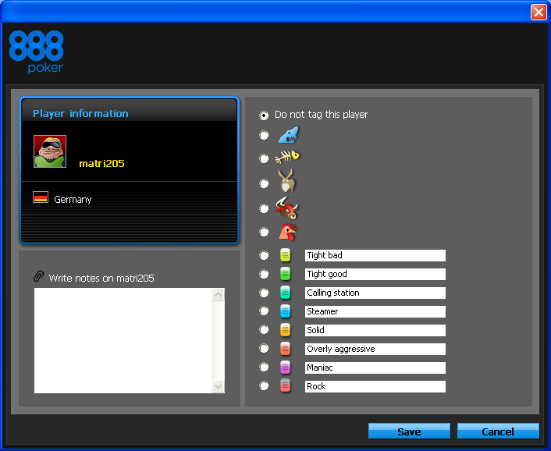
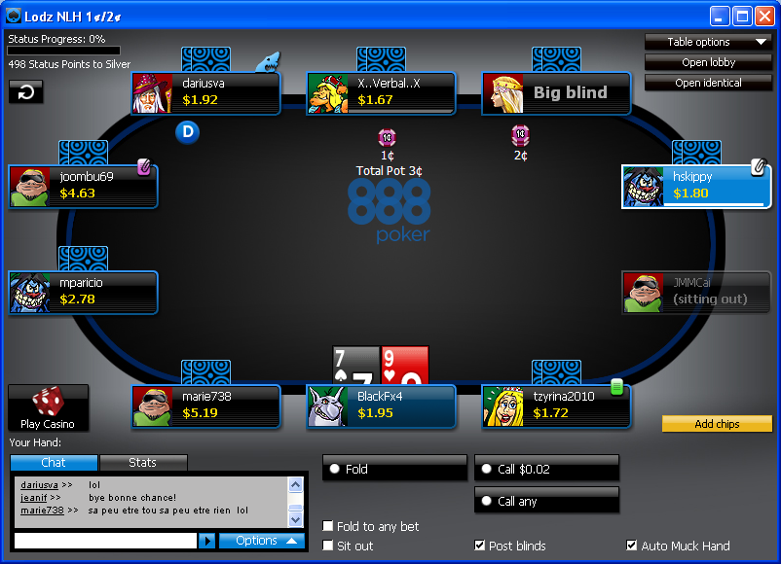
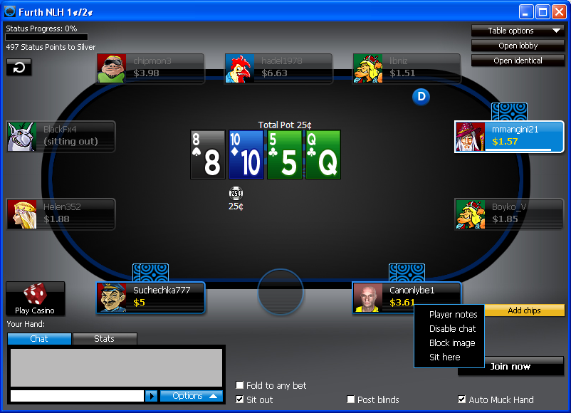
Marking Other Players
Player’s username and personal image
A player can tag opponents using the animal icons
Player’s registration country
An opponent with a colored tag and notes
Personal notes area
An opponent tagged with color plate (tight good)
Or they can use the old colored tags (backward compatibility)
Player’s notes screen is opened using the right-click menu on an opponent’s plate
A “shark tagged” opponent (might have notes as well)
An opponent with notes (white plate)
18

Slide 19
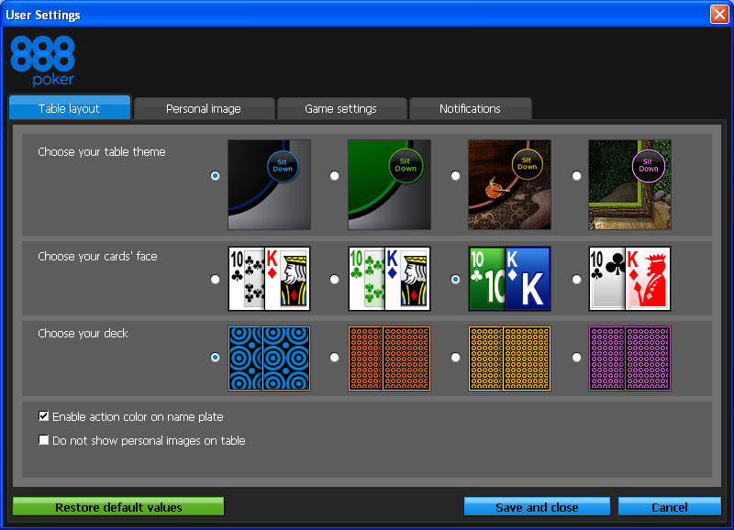
Setting Screen – table layout tab
The two decks in the middle are 4-color decks
Players who don’t wish to see personal images on the table, can remove them using this checkbox
Once the player finished adjusting their settings (in other tabs as well), they can press the Save and close button to save the new settings and exit the screen
This button restores the default settings in the client.
Color indication can be disabled on the table using this checkbox
The player can customize their table theme, cards’ face and deck.
19

Slide 20
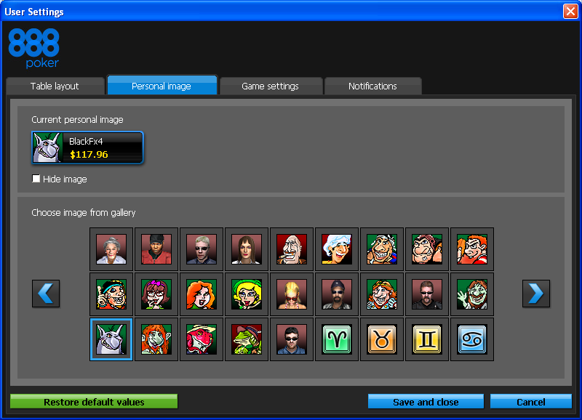
Setting Screen – personal image tab
Players can choose a personal image from a variety of more than 350 images, including cartoon characters, luck & holiday symbols and flags of all the nations.
A player can hide their own image if they wish to
20

Slide 21
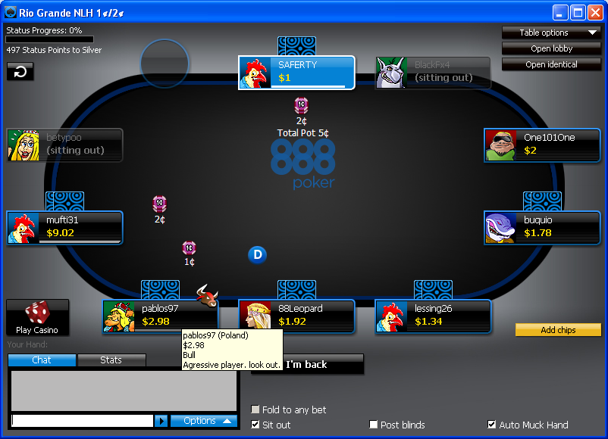
Table – opponent’s tooltip
Mouse over the opponent’s plate will reveal a tooltip with the opponent’s username, country, bankroll, tag and notes
21

Slide 22
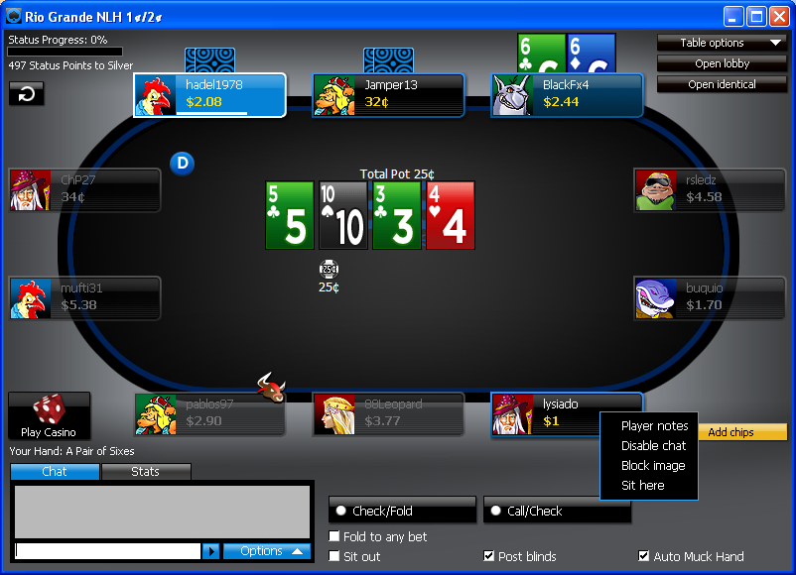
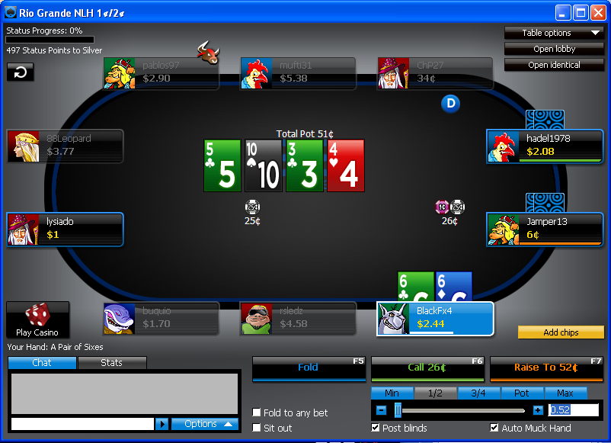
Table – sit here feature
The player can switch seats while seated around the table, using the Sit here option
The player switched places
22

Slide 23
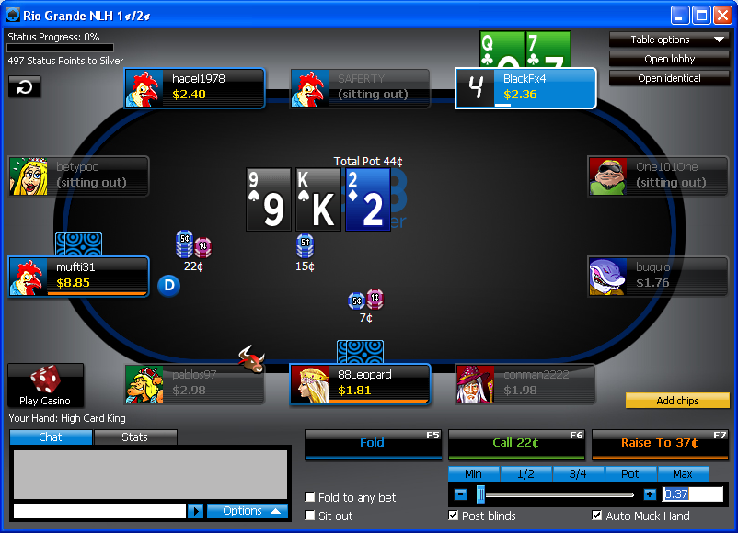
Countdown on last 7 seconds
23

Slide 24
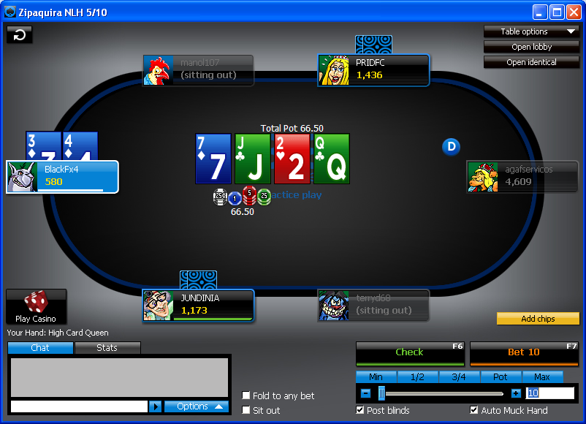
Short-handed Table
24

Slide 25
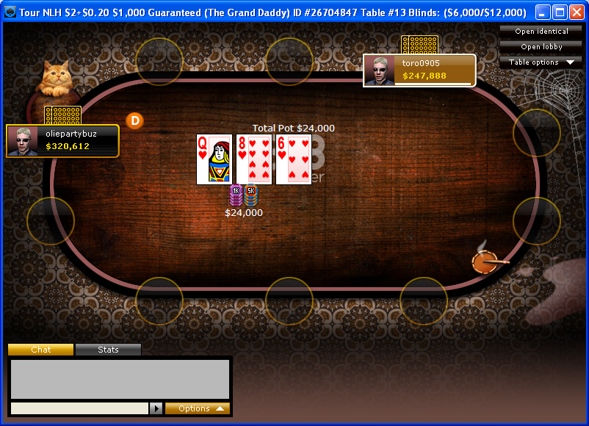
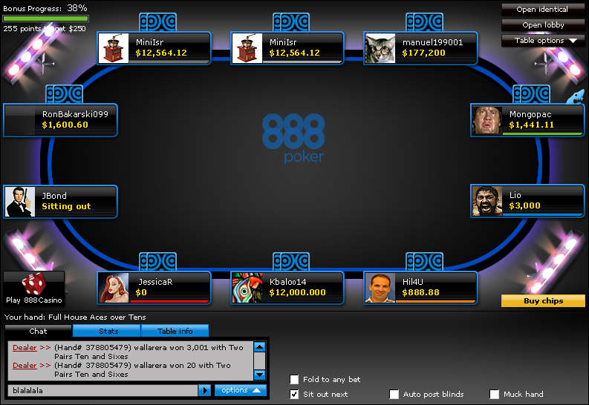
Tournament’s Final Table
25

Slide 26
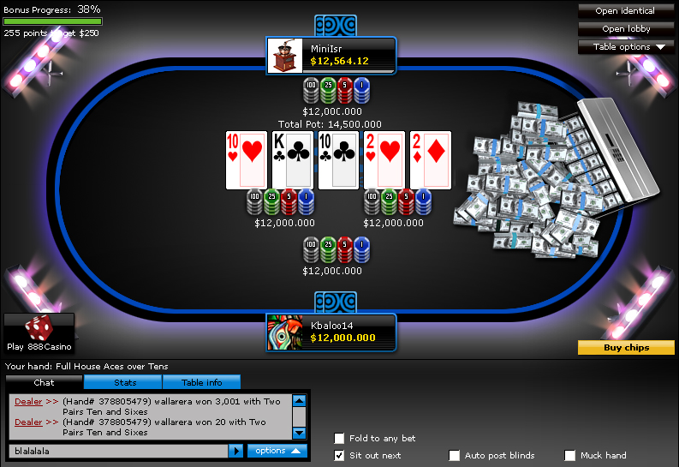
Tournament’s Final Table – Heads-Up
26

Slide 27
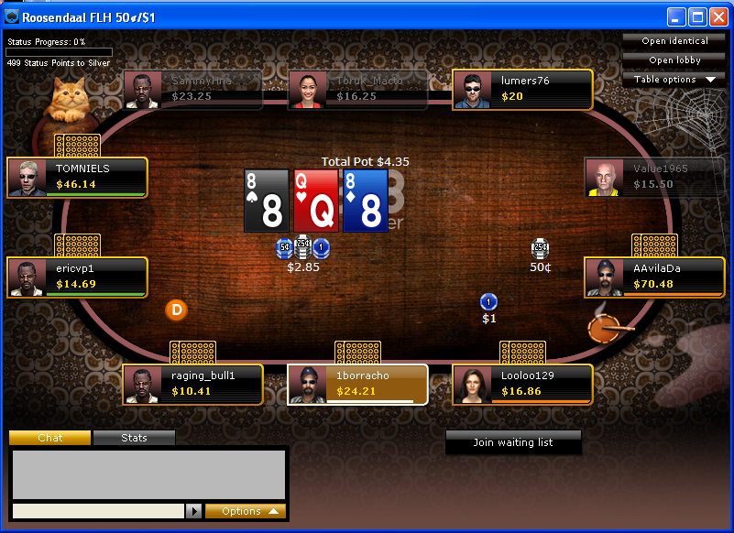
Table –’cabin’ skin
27

Slide 28
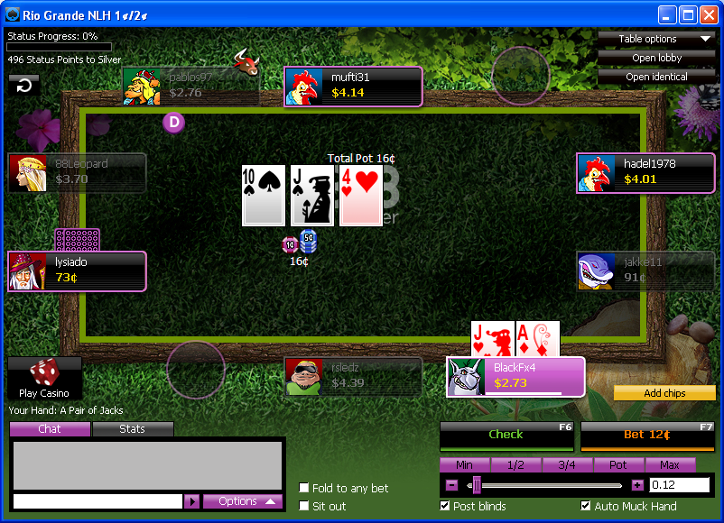
Table – grass skin
28

Slide 29
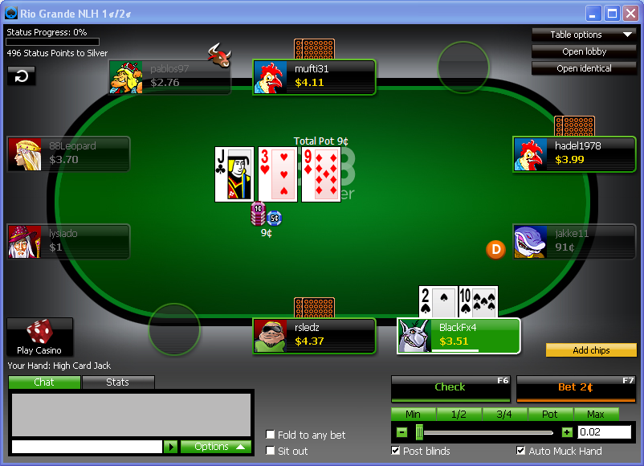
Green felt table
29

Slide 30
The End
30

